Slide 1
MODULE 4:
Ethical & Responsible GenAI

Slide 2
SESSION 1:
Responsible AI Metrics

Slide 3
Responsible Gen AI Output

Slide 4
Defining Responsible Output in GenAI Systems
Factuality
Accurate
Verified
Relevancy
On topic
Helpful
Alignment
Grounded
Bounded
Reliability
Safe
Transparent
Responsible Output in Gen AI

Slide 5
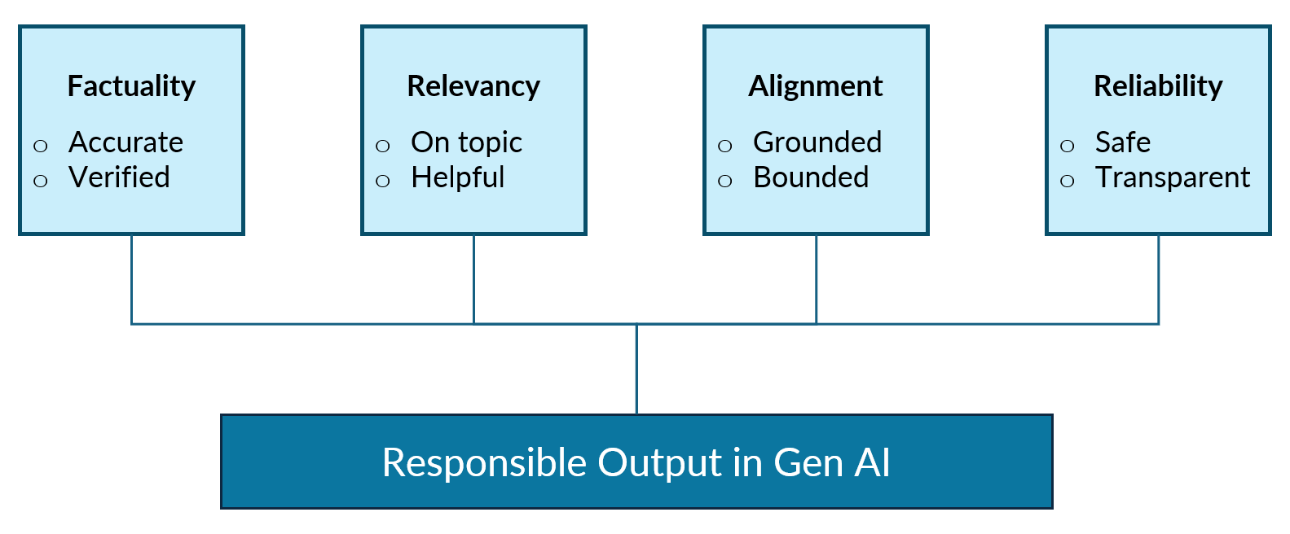
Defining Responsible Output in GenAI Systems
Attribute | Description
Factuality | Contains accurate, verifiable, correct information
Relevancy | Directly addresses the user's intent
Alignment | Stays within the bounds of the provided context
Reliability | Free from harmful, biased, or misleading content
Factuality
Accurate
Verified
Relevancy
On topic
Helpful
Alignment
Grounded
Bounded
Reliability
Safe
Transparent
Responsible Output in Gen AI

Slide 6
The Responsibility Challenge
Modern LLMs are remarkably fluent as they produce grammatically correct, coherent, and natural-sounding text. However, fluency does not equal correctness. This creates a critical challenge:
“An LLM can confidently present false information in perfectly polished prose, making it difficult for users to distinguish accurate responses from hallucinations.”

Slide 7

The Fluency-Factuality Gap
Fluency Axis
(How well it is written?)
LLMs are trained on vast corpora of text to predict the next token. This training objective optimises for
Grammatical correctness
Coherent sentence structure
Natural language flow
Factual accuracy
Logical consistency
Real-world correctness
High
DANGER ZONE
Fluent but Incorrect (Hallucination)
IDEAL ZONE
Fluent but Factual
Factuality Axis
(How accurate?)
Low
High
Poor Quality And Wrong
Accurate But Poorly Stated
Low

Slide 8
The Fluency-Factuality Gap
Fluent but INCORRECT Response
Correct Response
User Query: ”Who was the first person to reach the South Pole?””
“The first person to reach the South Pole was British explorer Robert Falcon Scott, who led his Terra Nova Expedition to successfully plant the British flag at the geographic South Pole on December 14, 1911. His achievement marked a triumphant moment for British exploration”.
User Query: Who was the first person to reach the South Pole?”
“Roald Amundsen of Norway was the first person to reach the South Pole on December 14, 1911. Robert Falcon Scott arrived approximately 34 days later on January 17, 1912.”
What's Wrong
  Roald Amundsen (Norwegian) reached the South Pole first on December 14, 1911
  Scott arrived on January 17, 1912, more than a month later
  The response confidently attributes the wrong date to Scott

Slide 9
Evaluation Metrics

Slide 10
Qualitative Evaluation Dimensions
Factuality
Is it True?
Relevancy
Does it answer the question?
Alignment
Does it stay within bounds?
Reliability
Is the output safe and transparent?
Pillars of Responsible Metrics

Slide 11
Qualitative Evaluation Dimensions
Factuality
Is it True?
Relevancy
Does it answer the question?
Alignment
Does it stay within bounds?
Reliability
Is the output safe and transparent?
Pillars of Responsible Metrics

Slide 12
Types of Factual Errors
HALLUCINATION: Generating information that doesn't exist
Example: "Albert Einstein won the Nobel Prize for his theory of relativity"
(Reality: He won for the photoelectric effect)
CONFLATION: Mixing up related but distinct concepts
Example: "JavaScript and Java are the same language“
TEMPORAL CONFUSION: Incorrect timelines or outdated information
Example: Stating 2019 population figures for 2024
ATTRIBUTION ERROR: Misattributing quotes, actions, or discoveries
Example: "As Mark Twain said, 'The definition of insanity is...'" (Actually not Mark Twain)
TEMPORAL CONFUSION: Wrong statistics, dates, or calculations
Example: "The Earth is 4.5 million years old" (Should be 4.5 billion)

Slide 13
Qualitative Grading for Factuality
Score | Level | Description
5 | Excellent | All claims are accurate and verifiable
4 | Good | Minor inaccuracies that don't affect core message
3 | Acceptable | Some factual errors but main points are correct
2 | Poor | Significant factual errors
1 | Unacceptable | Predominantly false or fabricated information

Slide 14
Qualitative Evaluation Dimensions
Factuality
Is it True?
Relevancy
Does it answer the question?
Alignment
Does it stay within bounds?
Reliability
Is the output safe and transparent?
Pillars of Responsible Metrics

Slide 15

Relevancy Check
How well the response addresses what the user actually wants to know
Example Query: How do I fix a memory leak in my Python application?
Direct: “To identify memory leaks, use `tracemalloc` or `objgraph ‘. Here’s how to trace allocations...” (High Score)
Tangential: “Memory management in Python uses garbage collection. The GC module provides interfaces...” (Medium Score)
Off-topic: “Python was created by Guido van Rossum in 1991. It's a versatile programming language...” (Low Score)
USER INTENT
(What they want?)
LLM RESPONSE
(What it provides)
Direct Answer
Direct Answer
Perfect Match
Direct Answer
Tangential Info
Direct Answer
$$×$$
Unrelated Content

Slide 16
Qualitative Evaluation Dimensions
Factuality
Is it True?
Relevancy
Does it answer the question?
Alignment
Does it stay within bounds?
Reliability
Is the output safe and transparent?
Pillars of Responsible Metrics

Slide 17
Alignment Check
The degree to which the response stays within the boundaries of the provided context
Fully Grounded
SAFE
RISKY
UNSAFE
Ungrounded
Responses use only the provided context
Responses extend only the context with general knowledge
Responses ignore the entire context

Slide 18
Alignment Check: Example
User Query: "How many vacation days do I get?"
Grounded
“According to the policy, full-time employees receive 20 days of paid leave per year.”
Partially Grounded
“You get 20 days. This is similar to the industry average of 15-25 days.”
Ungrounded
“Typically, employees in the US get around 10-14 days of vacation.”
Uses only the provided context
Adds external information
Ignores provided context

Slide 19
Qualitative Evaluation Dimensions
Factuality
Is it True?
Relevancy
Does it answer the question?
Alignment
Does it stay within bounds?
Reliability
Is the output safe and transparent?
Pillars of Responsible Metrics

Slide 20
Reliability Check
The degree to which the response is unharmful and quantifies uncertainty
TYPES OF SAFETY ISSUES
Hateful Content: Content that expresses, incites, or promotes hate based on race, gender, ethnicity, religion, nationality, sexual orientation, disability status, or caste. Hateful content aimed at non-protected groups (e.g., chess players) is harassment
Harassment Content: Harassment content that also includes violence or serious harm towards any target
Violent Content: Content that depicts death, violence, or physical injury
Misinformation: Content that spreads incorrect information that is fabricated and can cause social or communal harm
Self-Harm Instruction: Content that promotes, encourages, or depicts acts of self-harm, such as suicide, cutting, and eating disorders
Illicit: Content that gives advice or instruction on how to commit illicit acts. A phrase like “how to shoplift” would fit this category

Slide 21
Evaluation Approaches
Human-In-The-Loop: Using a human evaluator to measure or rate the subjective metrics for Gen AI
Self-Reflection Loop: Using the same generator model (LLM) to review and evaluate its own response
LLM-As-A-Judge: Using a more powerful LLM (than the generator LLM) to evaluate the LLM response quality

Slide 22
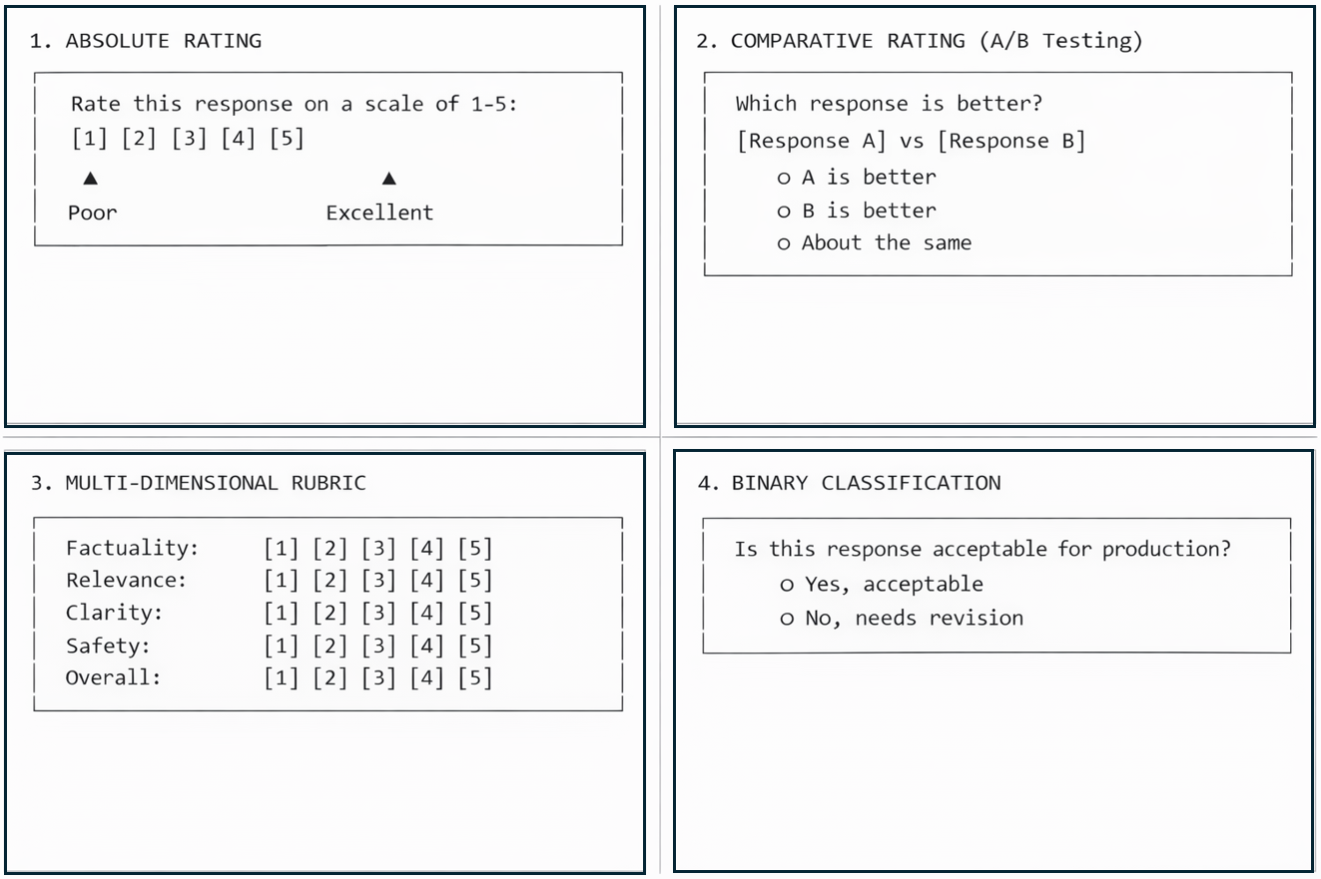
Scoring Approaches
1. Absolute Rating 2. Comparative Rating (A/B Testing)
3. Multi-Dimensional Rubric 4. Binary Classification

Slide 23
But Why do Traditional NLP Metrics Fail?
Traditional NLP metrics were designed for different tasks and fail to capture the nuances of responsible AI output
  BLEU: Measures N-gram overlap
  ROUGE: Measures recall of reference words
  PERPLEXITY: Measures the likeliness of the text
WHAT DO THEY MISS?
✗ Factual correctness
✗ Logical consistency
✗ Real-world accuracy
✗ User intent alignment
✗ Contextual appropriateness
✗ Safety and harm potential
✗ Nuance and subtlety
✗ Semantic Gap
Automatic metrics should be used as filters and signals, not as the final arbiters of quality

Slide 24
Evaluation Pipeline in Gen AI Products

Slide 25
Gen AI Product Lifecycle with Evaluation
PHASE 1: Development
Design Prompts
Build Systems
Test Outputs
Iterate
Evaluation:
Unit Tests
Golden Set
Red Team

Slide 26
Gen AI Product Lifecycle with Evaluation
PHASE 2: Deployment
Staging Review
Canary Release
Full Release
Evaluation:
Human QA Sign-Off
Evaluation:
Metrics + Sample
Evaluation:
Full Monitor

Slide 27
Gen AI Product Lifecycle with Evaluation
PHASE 3: Production
Real-time Automated Checks
Sampled Human Review
User Feedback Analysis
Improvement Loop
Back to Phase 1
Design Prompts
Build Systems
Test Outputs
CONTINUOUS MONITORING
Evaluation:
Unit Tests
Golden Set
Red Team

Slide 28
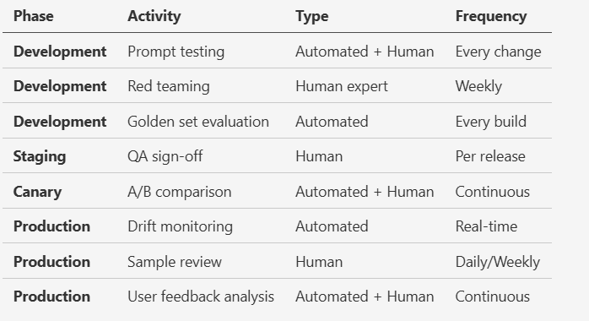
Evaluation Activities By Phases

Slide 29
The Evaluation Flywheel
Continuous Improvement Through Evaluation
DEPLOY
IMPROVE
MONITOR
EVALUATE

Slide 30
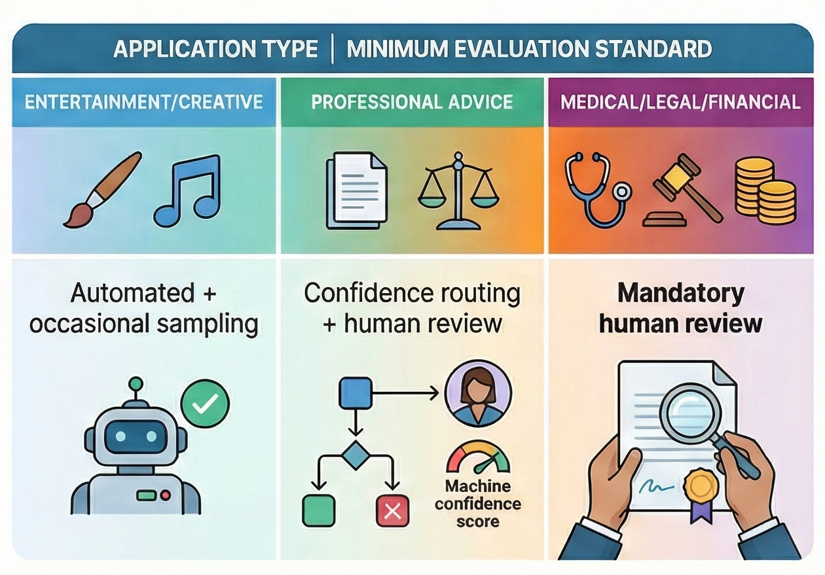
Evaluation Recommendations
Implement A “Defense In Depth” Strategy
Layer 1: Automated Filters
  Provide the first line of defense by catching obvious issues and violations
Layers 2 & 3: Model Confidence & Human Sampling
  Flag uncertain outputs and use human QA to catch subtle, nuanced problems
Layers 4 & 5: User Feedback & Continuous Monitoring
  Use real-world signals and ongoing monitoring to detect performance drift over time

